Slide 1
Veine Azygos

Slide 2
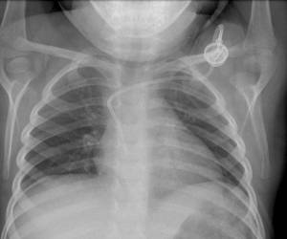
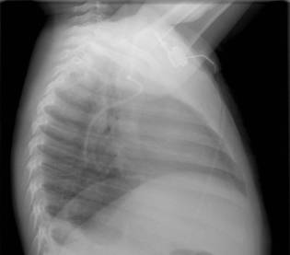
Azygos position

Slide 5
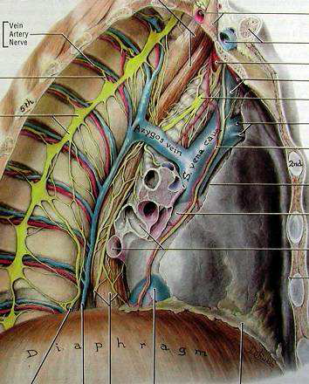

Slide 7
How to avoid this location?
Push the catheter in the right atrium and then pull back it in the maximal P wave position

