Slide 1






Comment je pronostique le devenir neurologique
20ème Congrès du CREUF - Chartres
Arrêt cardiaque
Alain Cariou
Intensive Care Unit – Cochin University Hospital
Paris Descartes University – INSERM U970 (France)
Notes:
First I would like to thank the organisators of this symposium for their kind invitation.
Since the aim of this session is to discuss about reperfusion injury, I will mainly focuse my presentation on the clinical and therapeutic aspect in the setting of the post-cardiac arrest which is in my opinion the best exemple of global ischemia and reperfusion experience in human.

Slide 2
Liens d’intérêts
Alain Cariou
CREUF 2014: Pronostic neurologique
Pulsion France
Bard Europe
Notes:
2

Slide 3
Spectre des anomalies de la conscience après arrêt cardiaque
Conscience
normale
Conscience
normale
Arrêt
cardiaque
?
Eveil
(Niveau de conscience)
Séquelles graves
ECM
ECM permanent
Coma
EV persistant
EV permanent
Mort cérébrale
Time
Adapté de Stevens RD et al. Crit Care Med 2006

Slide 4
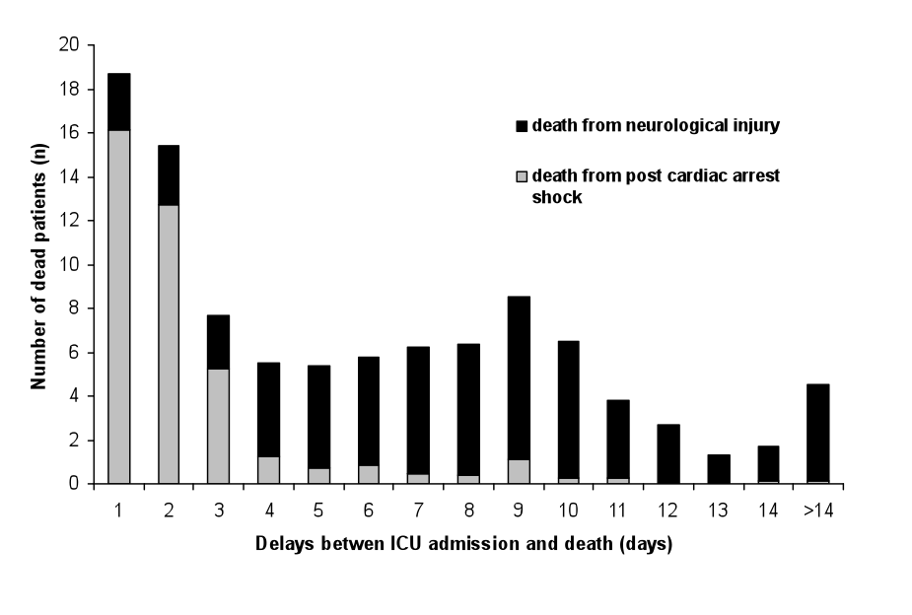
ICU mortality after cardiac arrest: the relative contribution of shock and brain injury in a large cohort
Lemiale V, Dumas F, Mongardon N, Giovanetti O, Charpentier J, Chiche JD, Carli P, Mira JP, Nolan J, Cariou A
Intensive Care Med 2013
n=499
Décès liés au choc post-AC (n=499)
n=768
Décès liés au choc post-AC (n=269)
“La principale cause de décès des patients admis en réanimation après un AC est directement en rapport avec les dégâts neurologiques provoqués par l’AC. En pratique, la majorité de ces décès est consécutive à une limitation ou un arrêt des thérapeutiques ”

Slide 5
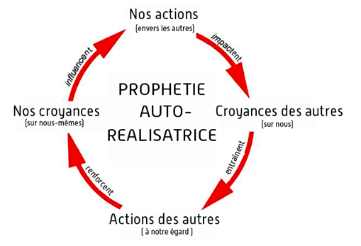

Pourquoi évaluer le pronostic après arrêt cardiaque?
Pour ne pas poursuivre des soins futiles ou inutiles
Pour ne pas abandonner des soins utiles

Slide 6
Prognosis assessment after CPR
« Prognosis for adults in PVS following cardiac arrest can be predicted with high accuracy after 3 to 7 days.
Withdrawal of life support, including artificially administered nutrition and hydration, is ethically permissible in these circumstances (…) »
J A M A 1993; 268: 2282-8
(Part VIII: Ethical considerations in resuscitation)

Slide 7

Quels outils ?
Examen clinique
Electrophysiologie
  EEG
  PES (N20)
Imagerie
  Scanner cérébral
  IRM
Biomarqueurs
  Protéine S-100
  Neuron-specific enolase (NSE)

Slide 9
Acute posthypoxic myoclonus after cardiopulmonary resuscitation
Bouwes A et al. BMC Neurology 2012
Evolution
favorable
(9%)
La survenue de myoclonies précoces est de très mauvais pronostic, mais une évolution favorable est parfois observée.

Slide 10
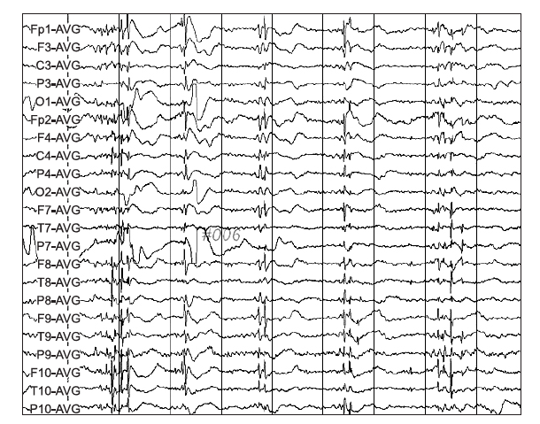
Lance-Adams syndrome (LAS)
Shin JH et al. Ann Rehabil Med 2012; 36: 561-564
43-year-old man
Anoxic CA
CPR followed by status epilepticus gradual recovery of consciousness
Contractions of muscles as if lightly jumping during sputum suction through the tracheostomy tube or pain stimulus, newly emerged…
“The precise cause of LAS is not known. Prognosis may be good when medications are appropriately administered and rehabilitation is done at an early stage of the disease. When a patient who regains consciousness after CPR has symptoms of myoclonus and is suspected of having LAS, (i) aggressive drug treatment to reduce the myoclonus and (ii) rehabilitation to prevent disabilities are necessary.”

Slide 11
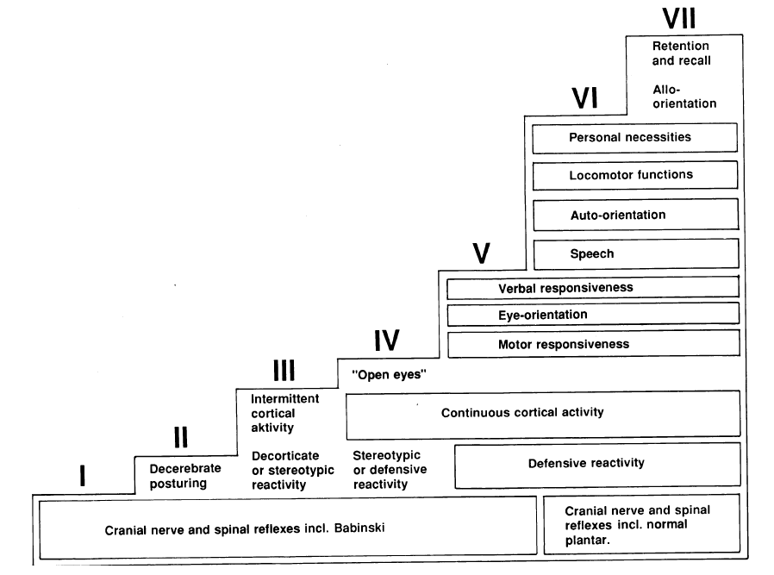
The natural course of neurological recovery following cardiopulmonary resuscitation
E.O. Jørgensen, S. Holm. Resuscitation 36 (1998) 111–122

Slide 12
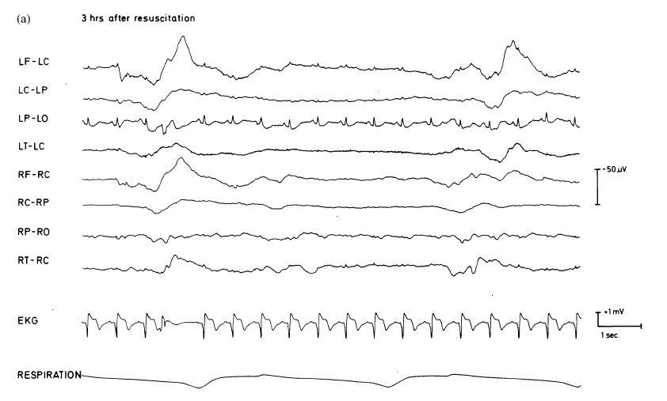
The natural course of neurological recovery following cardiopulmonary resuscitation
E.O. Jørgensen, S. Holm. Resuscitation 36 (1998) 111–122

Slide 13
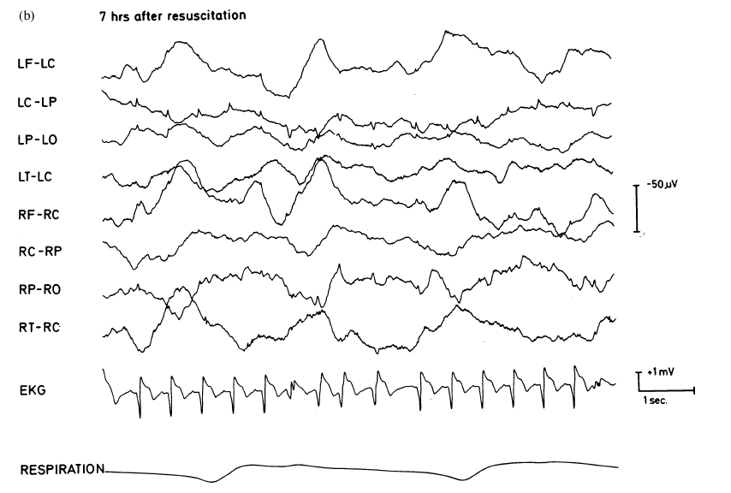
The natural course of neurological recovery following cardiopulmonary resuscitation
E.O. Jørgensen, S. Holm. Resuscitation 36 (1998) 111–122

Slide 14
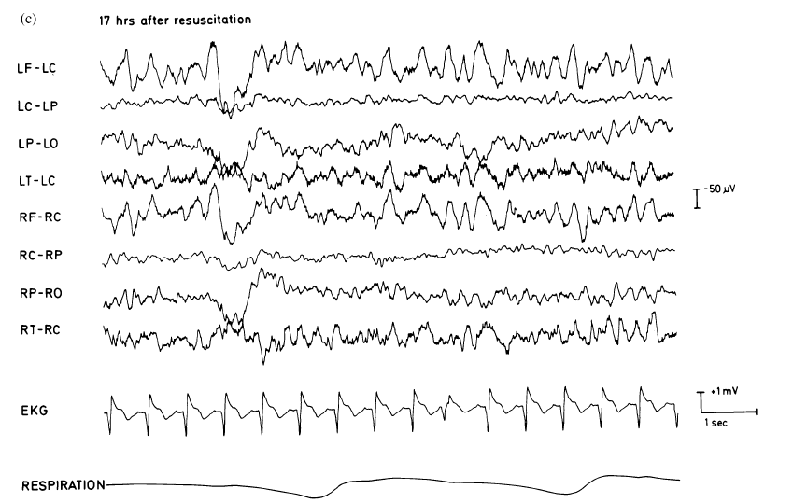
The natural course of neurological recovery following cardiopulmonary resuscitation
E.O. Jørgensen, S. Holm. Resuscitation 36 (1998) 111–122

Slide 15
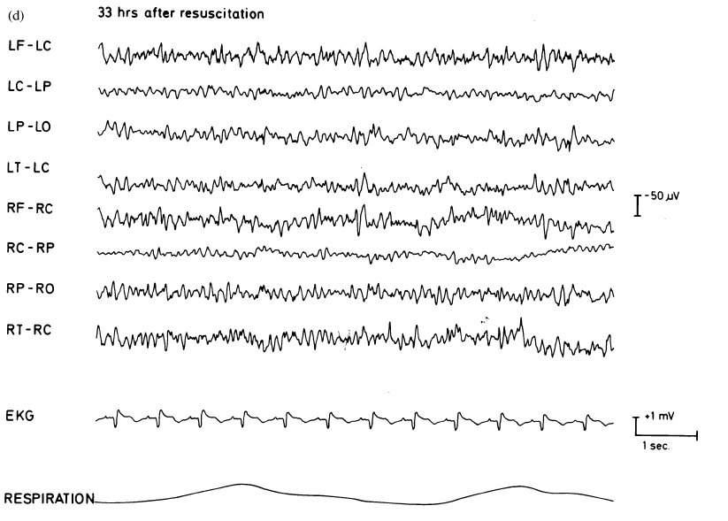
The natural course of neurological recovery following cardiopulmonary resuscitation
E.O. Jørgensen, S. Holm. Resuscitation 36 (1998) 111–122

Slide 16
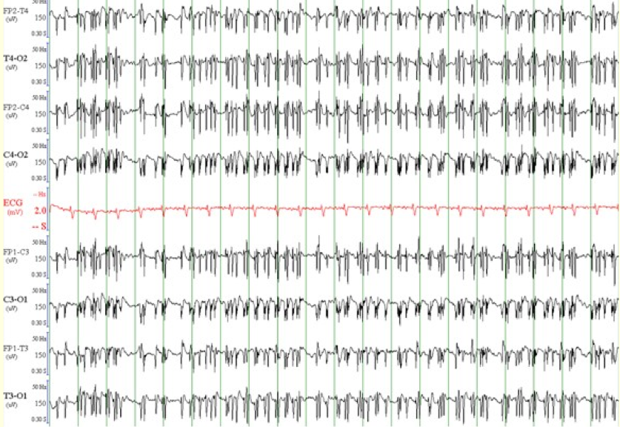

Slide 17
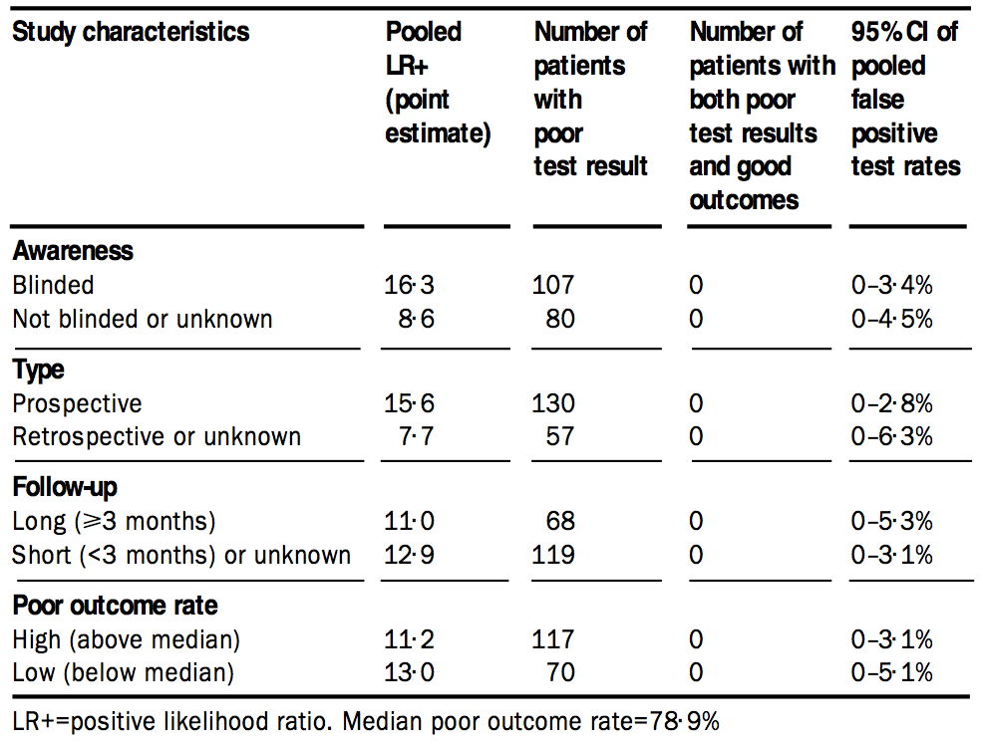
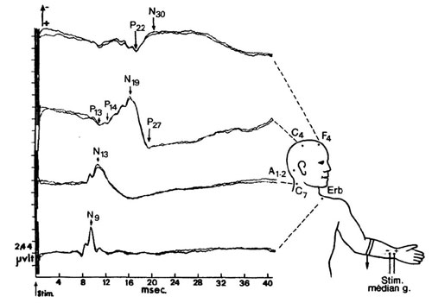
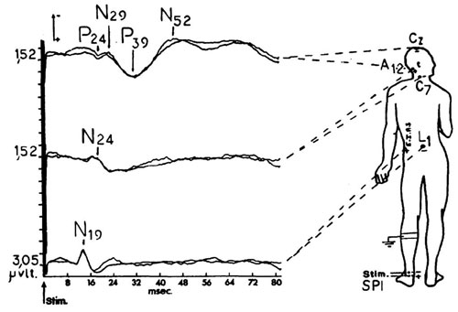
Potentiels évoqués somesthésiques
Zandbergen EGJ, et al., Lancet 1998:352:1808-1812

Slide 18
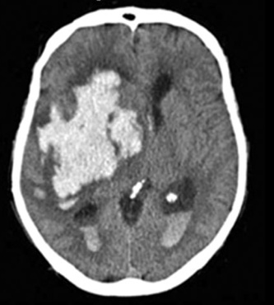
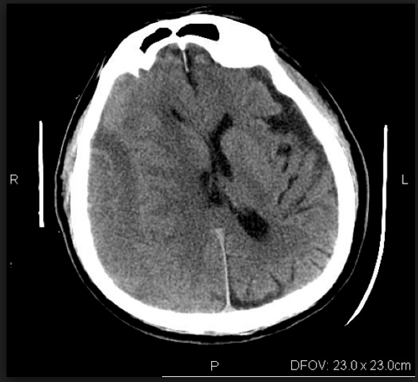
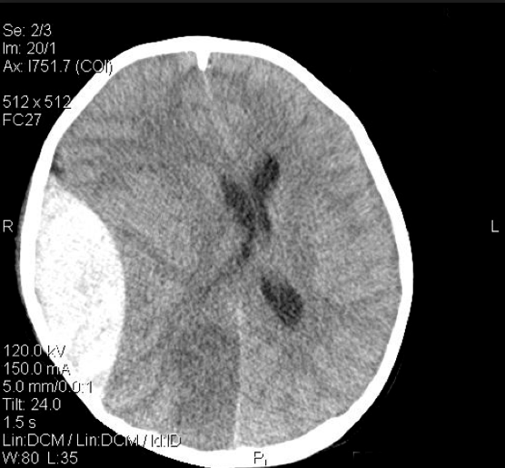

Slide 19
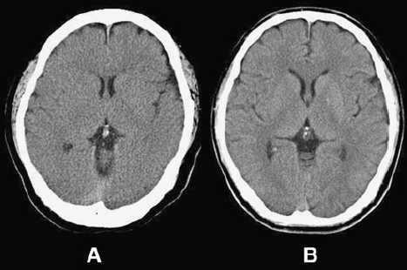
Early brain computed tomography findings are associated with outcome in patients treated with therapeutic hypothermia after out-of-hospital cardiac arrest
Kim SH et al. Scand J Trauma Emerg Med 2013
Changes in GM-to-WM ratios (GWRs)
Low ratio (abnormal)
High ratio (normal)

Slide 20
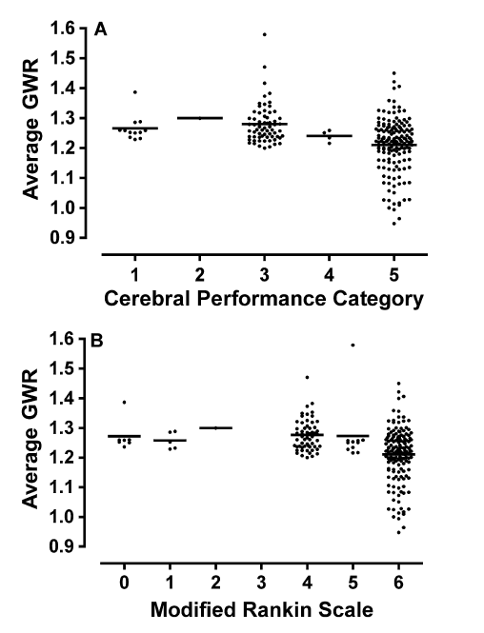
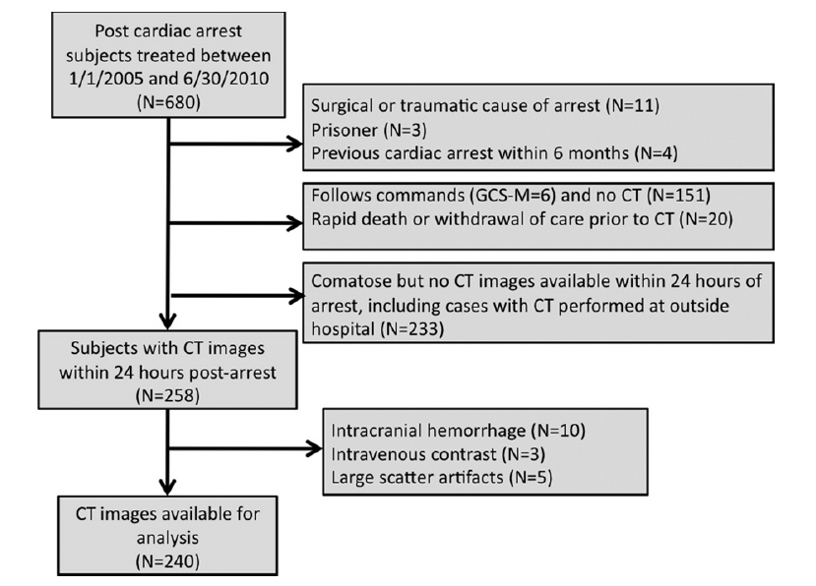
Association between a quantitative CT scan measure of brain edema and outcome after cardiac arrest
Metter RB et al. Resuscitation 2011

Slide 21
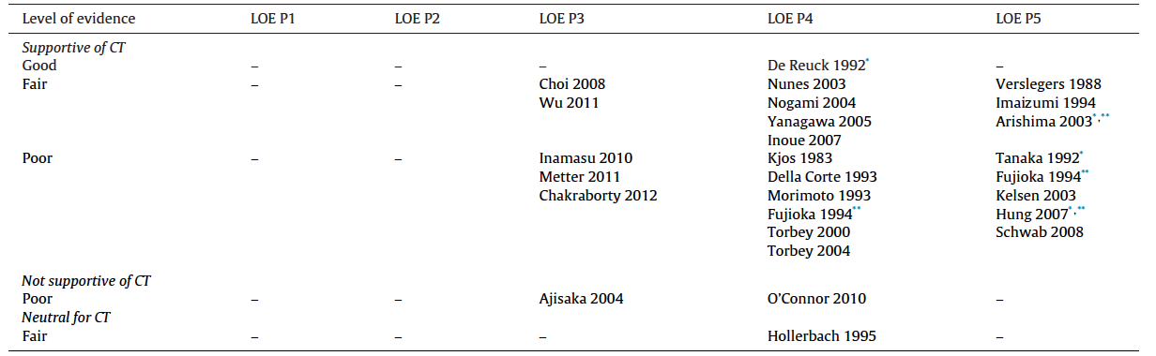
Quality of evidence in studies evaluating neuroimaging for neurologic prognostication in adult patients resuscitated from cardiac arrest
Hahn DK et al. Resuscitation 2014
“(…) the quality of the available literature is not robust, highlighting the need for higher quality studies before neuroimaging can be supported as a standard tool for prognostication in the patient population”

Slide 22
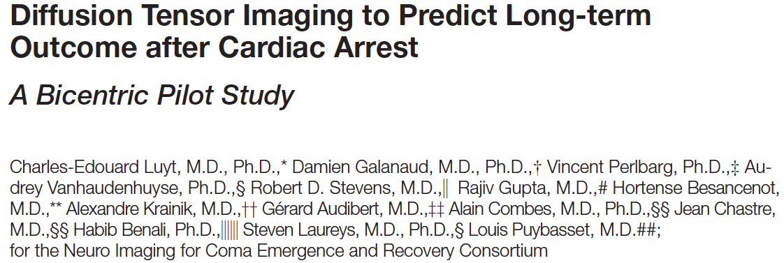
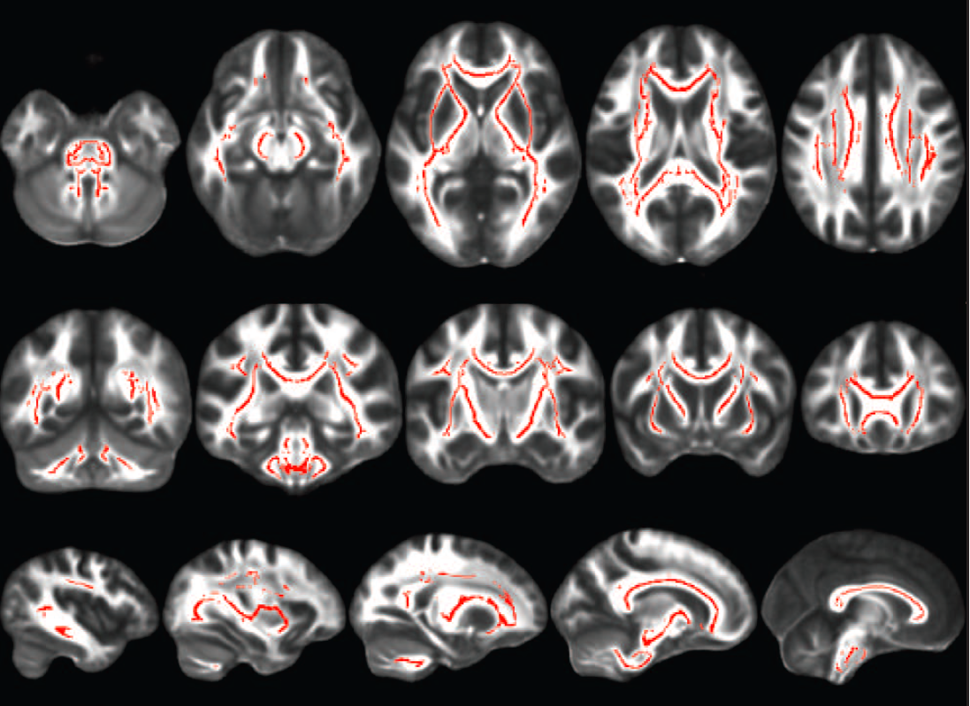
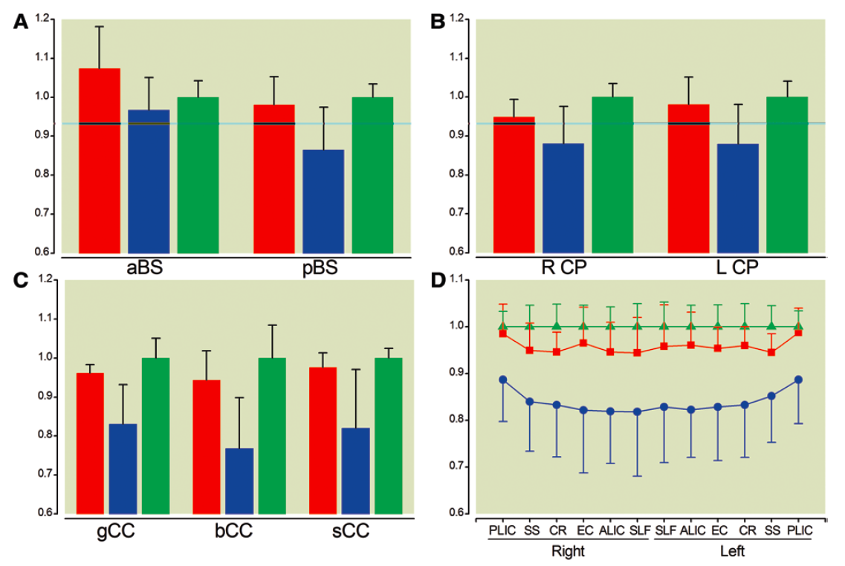
Nombreux problèmes à résoudre :
Validation
Applicabilité
Timing de réalisation
« Population-cible » ?

Slide 23
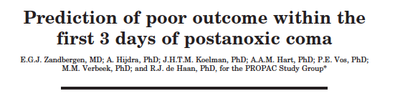
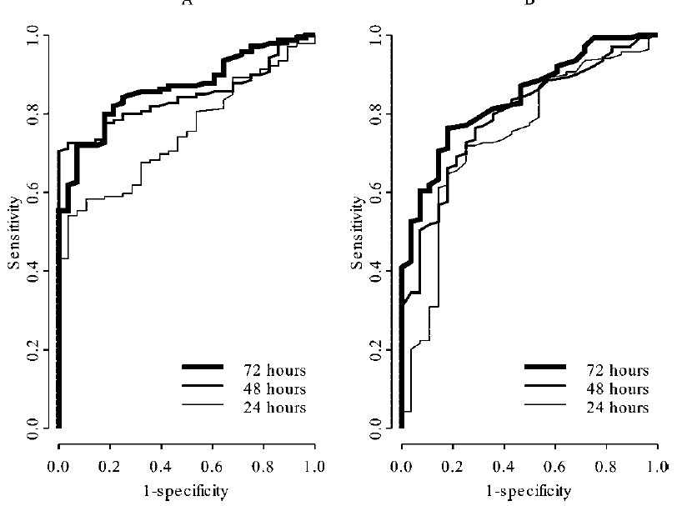
NSE
P S-100
Zandbergen et al. Neurology 2006

Slide 24


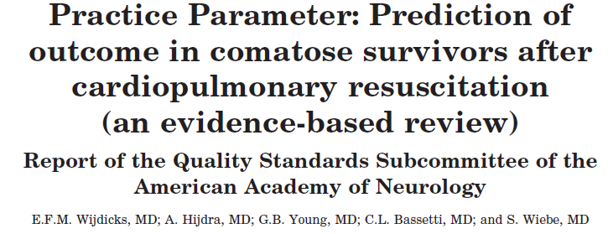
Neurology 2006; 67:203-10

Slide 25
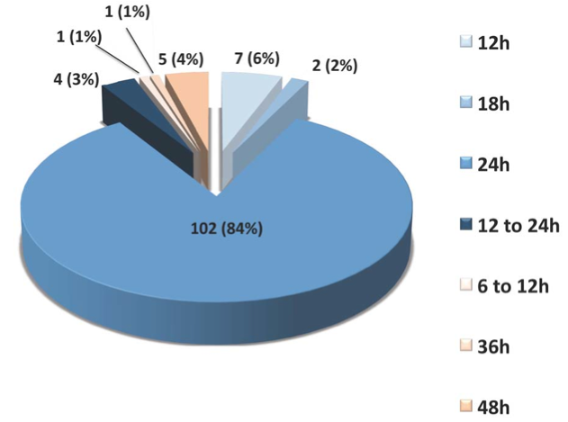
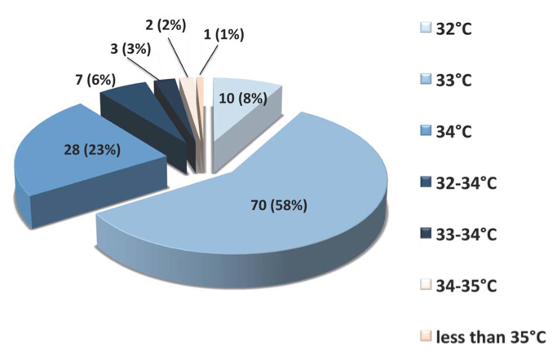
The practice of therapeutic hypothermia after cardiac arrest in France: a 23 national survey
Orban JC, Cattet F, Lefrant JY, Leone M, Jaber S, Constantin JM, Allaouchiche B and Ichai C for the AzuRéa group. Plos One 2012
132 questionnaires retournés (taux de réponse = 37% [32- 42%])
126 services dans l’analyse finale
Une hypothermie thérapeutique est pratiquée après un arrêt cardiaque sur fibrillation ventriculaire dans 119 services (99% [97-101%] et après asystolie dans 111 services (93% [88-98%]).

Slide 26
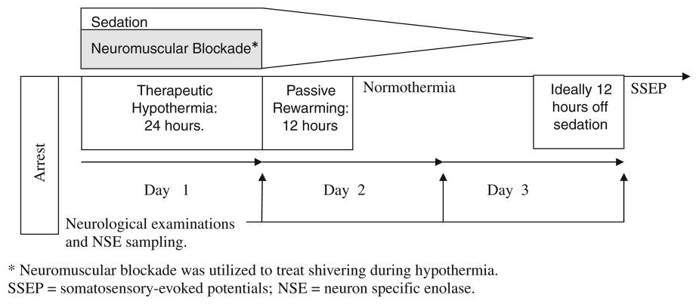
Sedation Confounds Outcome Prediction in Cardiac Arrest Survivors Treated with Hypothermia
Samaniego AS, Mlynash M, Finley Caulfield A, Eyngorn I, Wijman CAC.
Neurocritical Care 2011
La pratique de l’hypothermie thérapeutique est associée à une sédation et à une curarisation qui retarde l’évaluation neurologique.

Slide 27
Sedation Confounds Outcome Prediction in Cardiac Arrest Survivors Treated with Hypothermia
Samaniego AS, Mlynash M, Finley Caulfield A, Eyngorn I, Wijman CAC.
Neurocritical Care 2011
Positive predictive value (PPV) of poor outcome when GCS-M is < 2

Slide 28
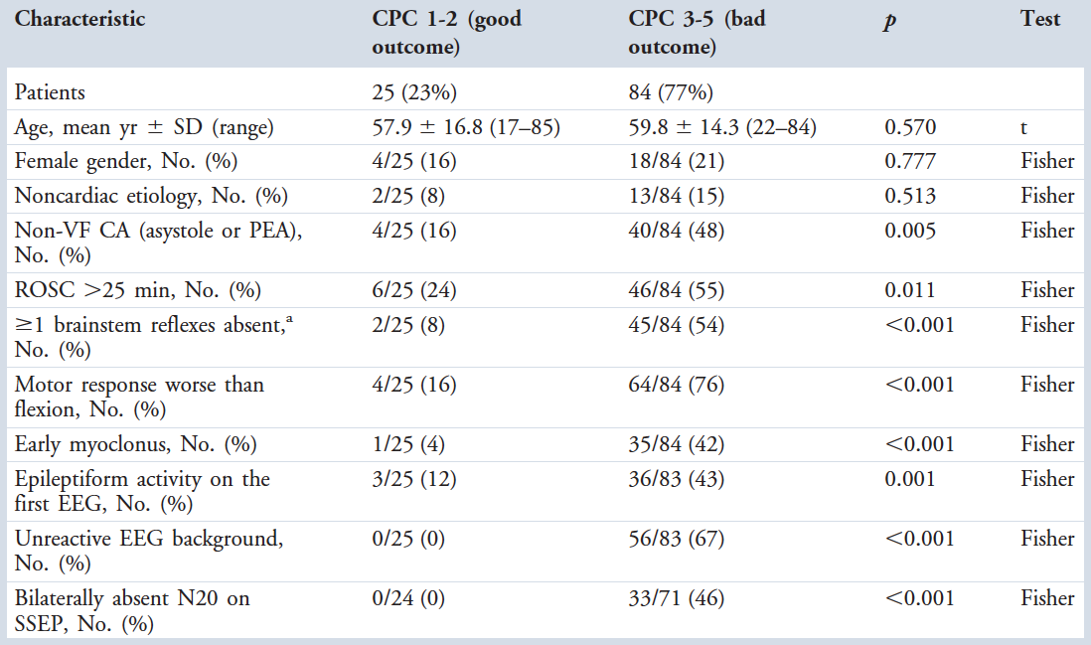
Prognostication after Cardiac Arrest and Hypothermia: A Prospective Study
Rossetti AO, Oddo M, Logroscino G, Kaplan PW. Ann Neurol 2010;67:301–7.
Frequency of Occurrence of Clinical and Electrophysiological Characteristics in Patients with Good versus Poor Functional Outcome at 3 to 6 Months

Slide 29
Prognostication after Cardiac Arrest and Hypothermia: A Prospective Study
Rossetti AO, Oddo M, Logroscino G, Kaplan PW. Ann Neurol 2010;67:301–7.
Frequency of Occurrence of Clinical and Electrophysiological Characteristics in Patients with Good versus Poor Functional Outcome at 3 to 6 Months

Slide 30
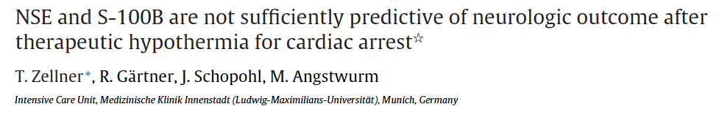

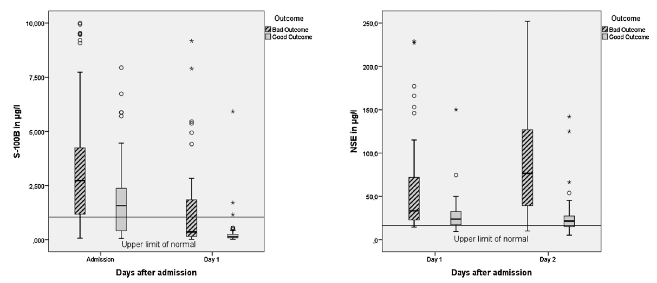

Slide 31
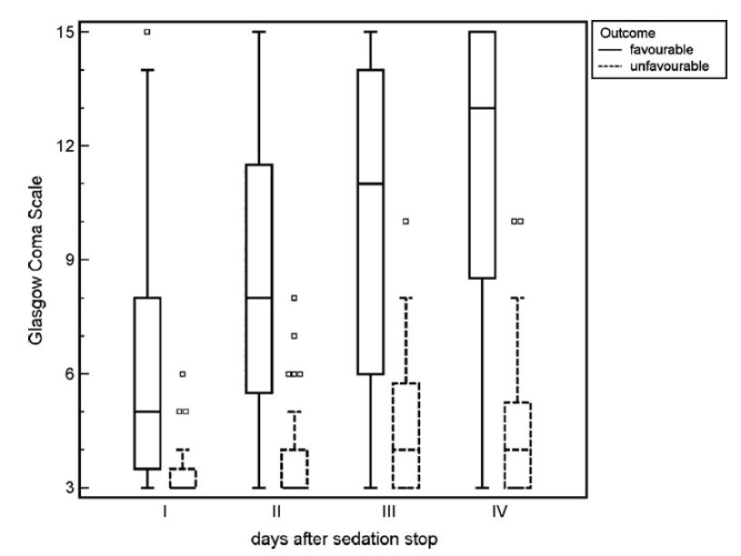
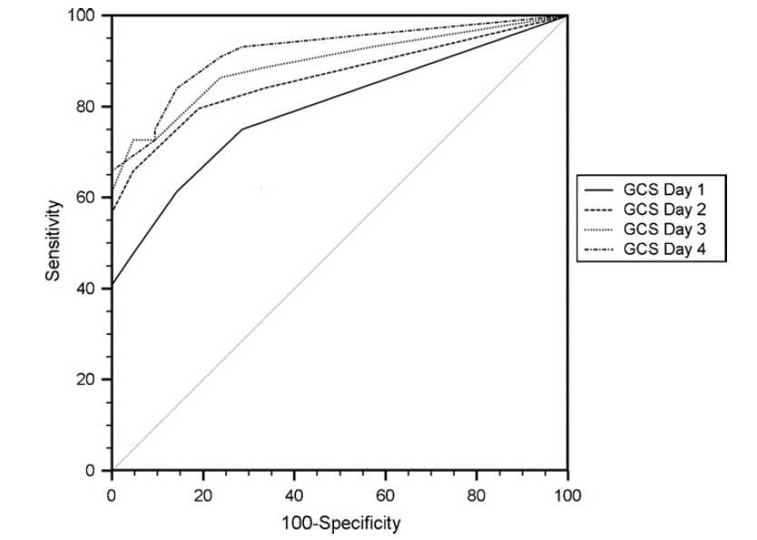
The Glasgow coma score is a predictor of good outcome in cardiac arrest patients treated with therapeutic hypothermia
Schefold JC et al. Resuscitation 2009; 80:658-61
Le score de Glasgow reste bas chez les patients à mauvais pronostic tandis qu’il augmente régulièrement chez les autres
GCS during the first 4 days after discontinuation of sedative medication in pts with favourable neurological outcome (n=44) and unfavourable outcome (n=28)

Slide 32
Prognostication in comatose survivors of cardiac arrest: An Advisory Statement from the European Resuscitation Council and the European Society of Intensive Care Medicine
Claudio Sandroni, Alain Cariou, Fabio Cavallaro, Tobias Cronberg, Hans Friberg, Cornelia Hoedemaekers, Janneke Horn, Jerry P. Nolan, Andrea O. Rossetti and Jasmeet Soar
Intensive Care Med 2014 (in press)
Aims was to:
Update and summarize the available evidence on this topic, including that on TH-treated patients;
Provide practical recommendations on the most reliable prognostication strategies, based on a more robust analysis of the evidence, in anticipation of the next ERC Guidelines on Resuscitation to be published in October 2015;
Identify knowledge gaps and suggest directions for future research

Slide 33
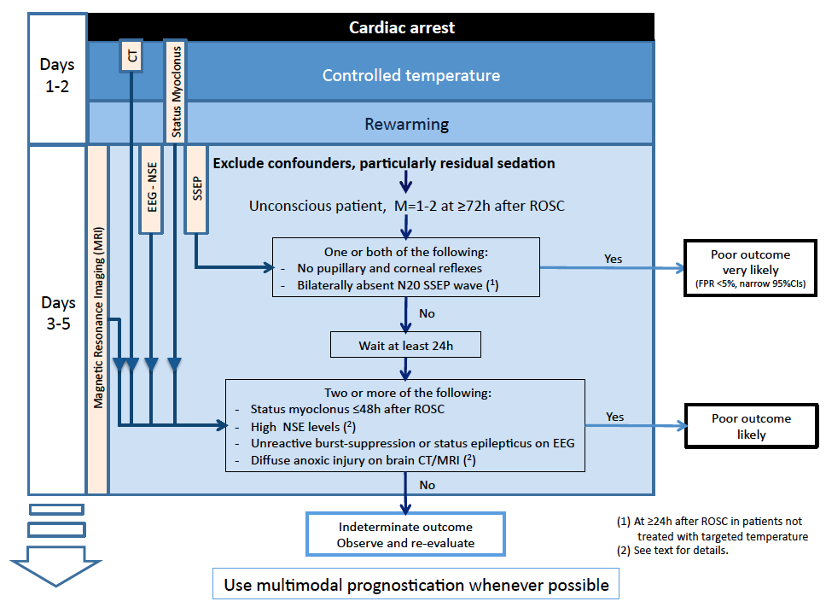

Slide 34
Conclusion
Utiliser une procédure… qui laisse de la place pour la discussion
Combiner les outils
Savoir attendre

